Slide 1
Machine Learning (MCIT-106)

Slide 2
Course Outcomes
After studying this course the student will be able to:
Apply Supervised Learning, Unsupervised learning, Deep Learning, Visualization techniques
Recognize and formalize a task as a machine learning problem
Interpret and present the predicted model
Identify suitable algorithms to tackle different machine learning problems
Apply machine learning algorithms to real datasets
Make powerful and accurate predictions.

Slide 3
Outline
Introduction - Overview of AI, ML, DL,
Artificial Intelligence Evolution,
Mathematical Background
Find out where AI, ML, DL is applied in Technology and Science.
Applications in real scenarios.

Slide 4
Traditional Programming vs Machine Learning
Traditional Programming refers to any manually created program that uses input data and runs on a computer to produce the output.
Machine Learning, also known as augmented analytics, the input data and output are fed to an algorithm to create a program. This yields powerful insights that can be used to predict future outcomes.

Slide 5
Traditional Programming vs Machine Learning
In traditional programming you hard code the behavior of the program. In machine learning, you leave a lot of that to the machine to learn from data.
Traditional programming is a manual process—meaning a person (programmer) creates the program. But without anyone programming the logic, one has to manually formulate or code rules
In machine learning, on the other hand, the algorithm automatically formulates the rules from the data.

Slide 6
Traditional Programming
Program
Data
Output

Slide 7
Machine Learning
Data
Output
Program

Slide 8
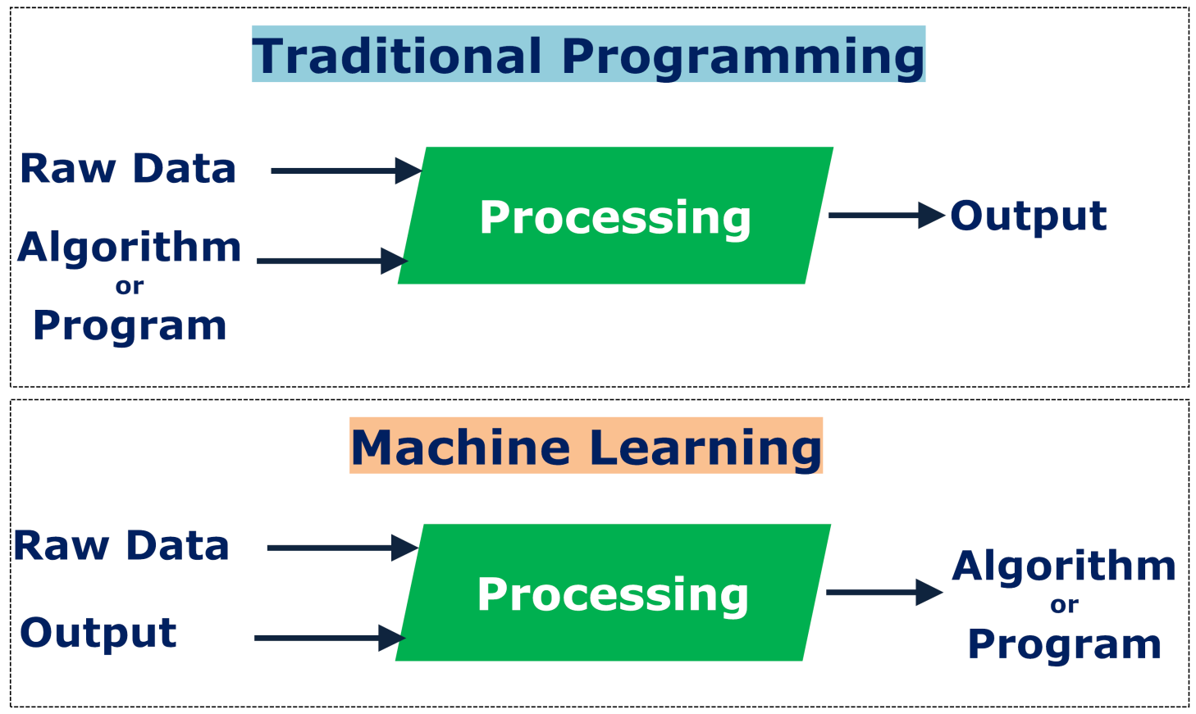
Machine Learning
“Machine Learning changes the way you think about a problem. The focus shifts from a mathematical science to a natural science, running experiments and using statistics, not logic, to analyse its results”
Peter-Norvig: Google Research Director
Machine learning is programming computers to optimize a performance criterion using example data or past experience

Slide 9
Machine Learning
Unlike traditional programming, machine learning is an automated process. It can increase the value of your embedded analytics in many areas, including data prep, natural language interfaces, automatic outlier detection, recommendations, and causality and significance detection.
All of these features help speed user insights and reduce decision bias.

Slide 10
Machine Learning
“Learning is any process by which a system improves
performance from experience”
Herbert Simon
Mathematical Definition by Tom Mitchell (1998):
Machine Learning is the study of algorithms that
improve their performance P
at some task T
with experience E
A well-defined learning task is given by <P, T, E>

Slide 11
Machine Learning
Field of study that gives the computer the ability to learn without being explicitly programmed –Arthur Samuel
Machine learning is a branch of AI in which a computer generates rules underlying or based on data that has been fed into it –dictinoary.com

Slide 12
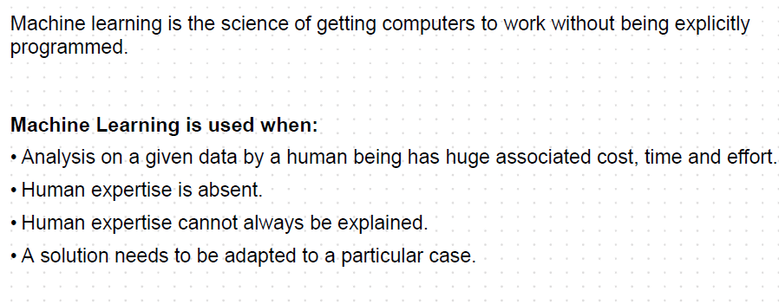
Machine Learning (Source: infyTq)

Slide 13
Where ML is useful?
Where human presence may not be possible/difficult
Navigating on Mars, Deep Oceans etc.
Humans are unable to use their skills effectively
Speech recognition, Face recognition, Handwritten Digit Recognition etc.
Solution changes quickly from time to time and on the fly
Routing on a Computer Network, Electric Grid
Manual calculation not possible due to huge amounts of data
Recommending a product to buyers by Amazon, Flipkart, Netflix etc.
Predicting an outcome from sensor data, e.g., Weather prediction

Slide 14
Why ML Should not be used?
Machine Learning is not always useful!
Examples:
Calculate payroll of an Organisation
Dispense money from ATM's and link back to your account balance
Calculate utility bills (Telephone, Electricity etc.)

Slide 15
Artificial Intelligence
The designing and building of intelligent agents that receive percepts from the environment and take actions that affect that environment.
Russel & Norvig, Artificial Intelligence: A Modern Approach
The theory and development of computer systems able to perform tasks normally requiring human intelligence, such as visual perception, speech recognition, decision-making, and translation between languages.
Oxford Dictionary, https://www.lexico.com/definition/artificial_intelligence
The ability of a digital computer or computer-controlled robot to perform tasks commonly associated with intelligent beings.
B.J. Copeland, https://www.britannica.com/technology/artificial-intelligence

Slide 16
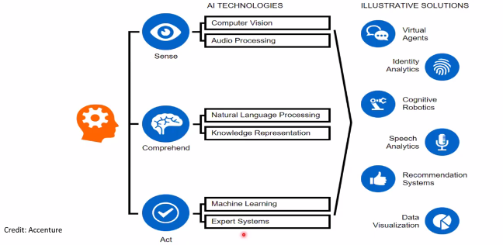
Emerging Artificial Intelligence

Slide 17
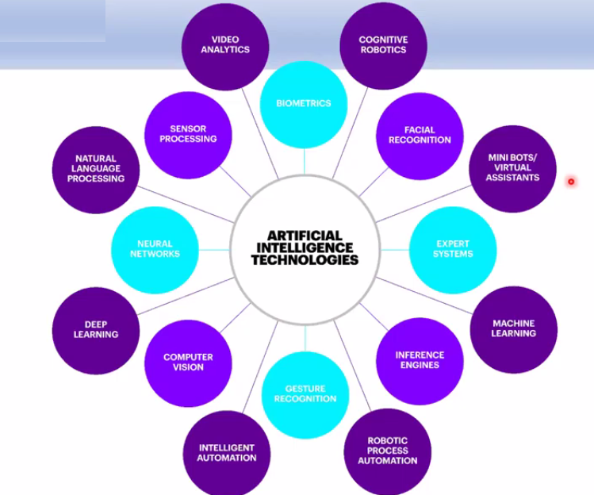
Emerging Artificial Intelligence

Slide 18
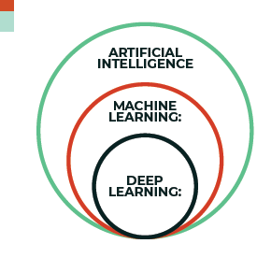
AI vs ML vs DL
Science that empowers computers to mimic human intelligence such as decision making, text processing, and visual perception.
AI is a broader field (i.e.: the big umbrella)
that contains several subfield such as machine learning, robotics, and computer vision.
Machine Learning is a subfield of Artificial Intelligence that enables machines to improve at a given task with experience. It is important to note that all machine learning techniques are classified as Artificial Intelligence ones.
However, not all Artificial Intelligence could count as
Machine Learning since some basic Rule-based engines could be classified as AI but they do not learn from experience therefore they do not belong to the machine learning category.

Slide 19
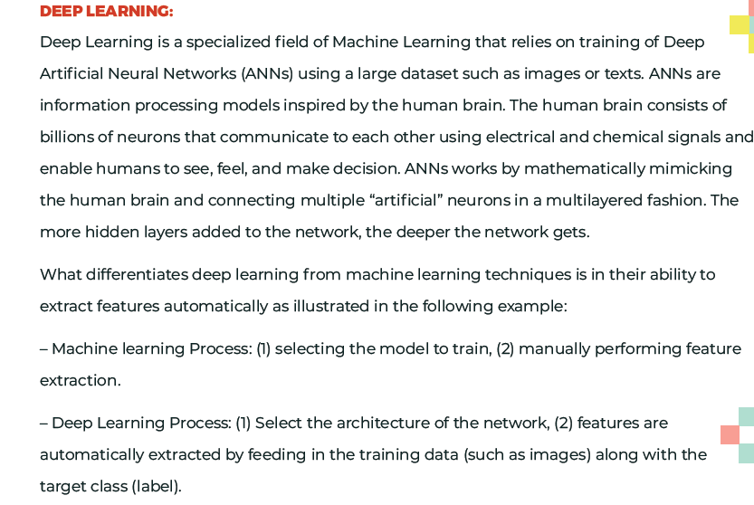
AI vs ML vs DL

Slide 20
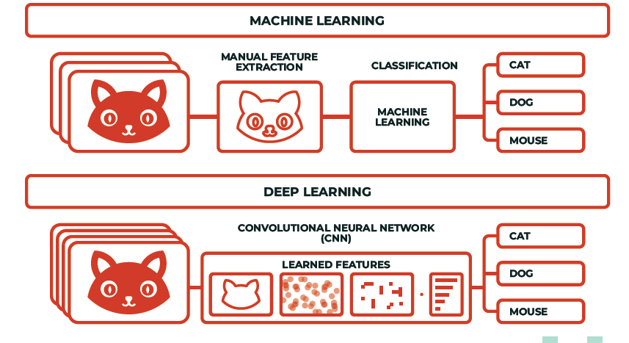
AI vs ML vs DL

Slide 21
Evolution
ENIAC – In 1946, first computer system ENIAC was developed.
First game playing program for checkers in 1952 by Arthur Samuel
Perception – In 1957 Frank Rosenblatt invented the Perception at the Cornell Aeronautical Laboratory. It one of the earliest algorithm for ML.
A very simple linear classifier
By combining a large number of them in a network, a powerful model could be created.
ELIZA – Developed in early 60’s by Jospeph Weizenbaum.
Simulated a psychotherapist by using tricks like string substitution and canned responses based on keywords.
When the original ELIZA appeared, some people mistook her for human.

Slide 22
Evolution
Statistical Al
Started in early 90s. The field shifted to more data driven approach as compared to the knowledge-driven expert systems developed earlier.
Big Data Analysis
As a result of the exponential growth in the amount of data that is available for scientific research, the science is on the brink of huge changes
Statistical Al is a centre piece of Big Data analysis
The aim is to develop new methods to store these substantial amounts, and to quickly find, analyse, and validate complex patterns in Big Data

Slide 23
Evolution
1994 – Self driving car road test
1997 – Deep blue beats Gary Kasparov
2009 – Google builds self driving car
2011 – Watson wins Jeopardy
2014 – Human Vision Surpassed by ML System
2015 – AlphaGo beats a human professional Go player
2019 – Deepfake - videos from just one picture as input
The saga continues …

Slide 24
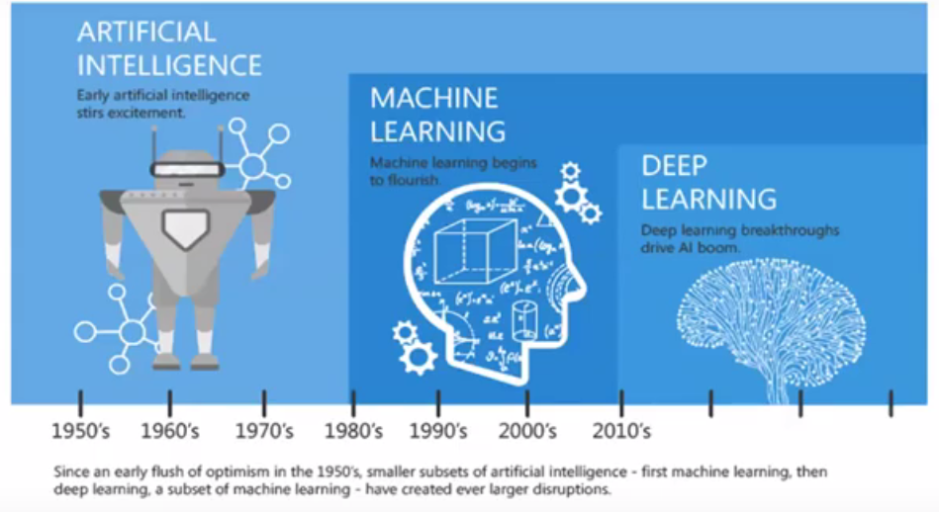
Evolution

Slide 25
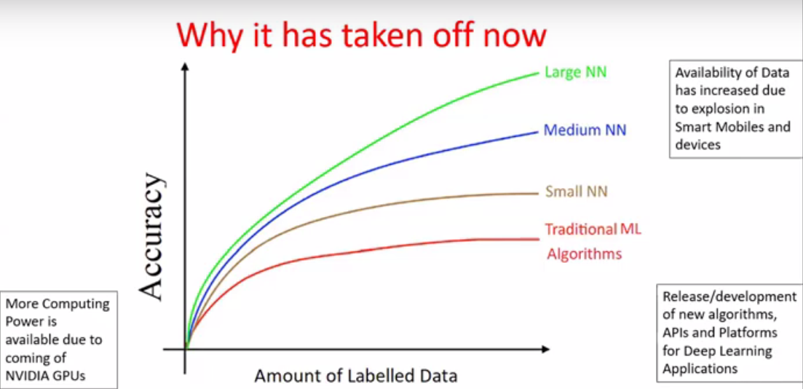
Evolution

Slide 26
Reasons?
New Software / Algorithms
Neural Network
Deep Learning
New Hardware – GPUs
Cloud as an Enabler
Advances in Big Data processing

Slide 27
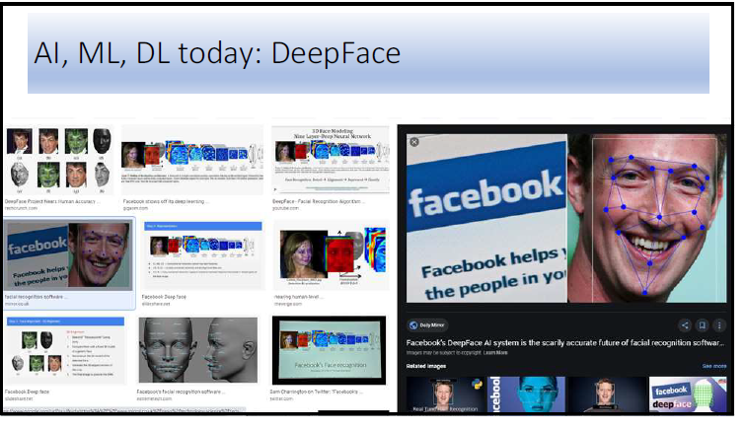

Slide 28
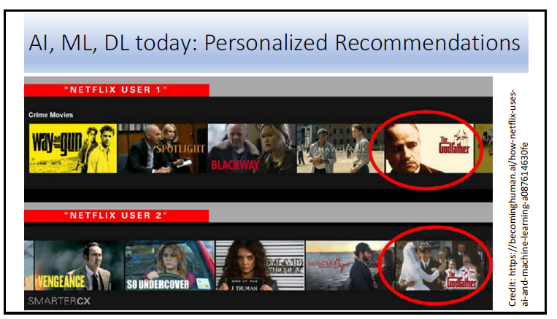

Slide 29
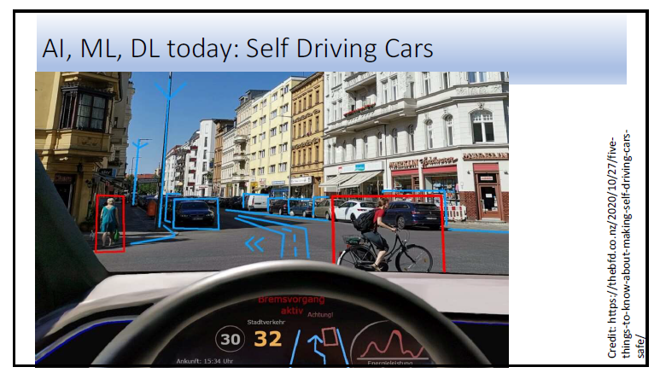

Slide 30
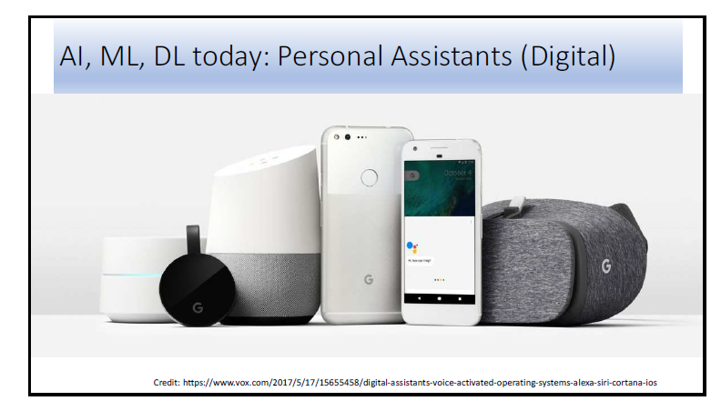

Slide 31
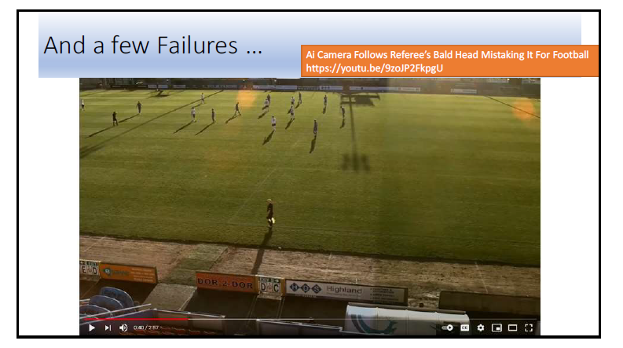

Slide 32
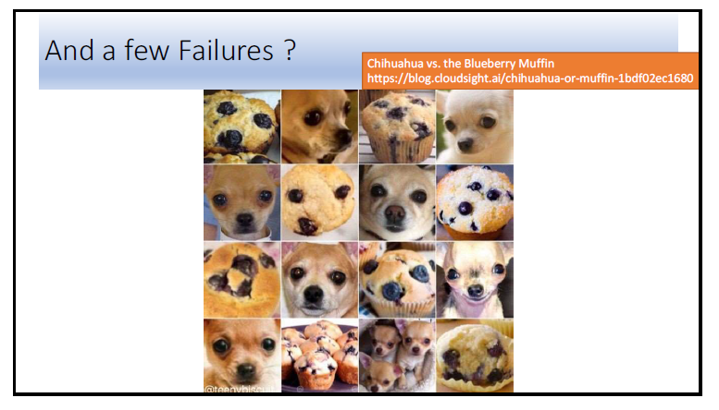

Slide 33
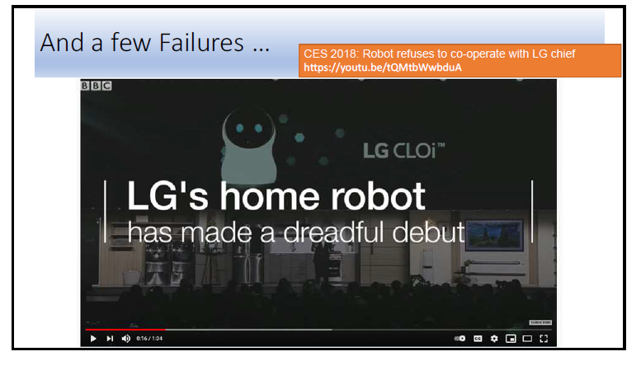

Slide 34
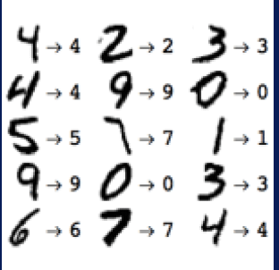

Applications of ML
Credit card fraud detection
Handwritten digit recognition
Recommender Systems

Slide 35
More Applications
Targeted ads on mobile apps
Sentiment analysis
Climate monitoring
Crime pattern detection
Drug effectiveness analysis
Translation Aps
Self Driven Cars

Slide 36
Data Engineers & Data Scientists
“Specialists known as data engineers are constantly finding innovative and powerful new ways to capture, collate, and condense unimaginably massive volumes of data,
other specialists known as data scientists are leading change by deriving valuable and actionable insights from that data.
data science represents process and resource optimization

Slide 37
Data Science
Data science produces data insights — insights you can use to understand and improve your business, your investments, your health and your lifestyle and social life
For any goal or pursuit you can imagine, you can find data science methods to help you know and predict the most direct route from where you
are to where you want to be — and anticipate every pothole in the road in between.

Slide 38
Data Science vs Data Engineering
Data science is the practice of using computational methods to derive valuable and actionable insights from raw datasets.
Data engineering, dedicated to overcoming data-processing bottlenecks and data-handling problems for applications that utilize large volumes, varieties, and velocities of data
In both domains, it’s common to work with the different types of data varieties

Slide 39
Data Science vs Data Engineering
Both are essential elements for any comprehensive decision-support system, and both are extremely helpful when formulating robust strategies for future business management and growth

Slide 40
Data Science
Use machine learning to optimize energy usages and lower corporate carbon footprints.
Optimize tactical strategies to achieve goals in business and in science.
Predict for unknown contaminant levels from sparse environmental datasets.
Design automated theft and fraud prevention systems to detect anomalies and trigger alarms based on algorithmic results.
Craft site-recommendation engines for use in land acquisitions and real estate development.
Implement and interpret predictive analytics and forecasting techniques for net increases in business value.

Slide 41
Data Engineering
Build large-scale Software as a Service (SaaS) applications.
Build and customize Hadoop and MapReduce applications.
Design and build relational databases and highly scaled distributed architectures for processing big data.
Extract, transform, and load (ETL) data from one database into another.

Slide 42
Forms of Data
✓Structured data: Data that’s stored, processed, and manipulated in a traditional relational database management system.
✓Unstructured data: Data that’s commonly generated from human activities and that doesn’t fit into a structured database format.
✓Semi-structured data: Data that doesn’t fit into a structured database system, but is nonetheless structured by tags that are useful for creating a form of order and hierarchy in the data

Slide 43
Examples - Forms of Data
Structured data
Like tables with fixed attributes
Traditionally handled by relational databases
Unstructured data
Usually generated by humans
E.g. natural language, voice, Wikipedia, Twitter posts
Must be processed into (semi-structured) data to gain value
Semi-structured data
Has some structure in tags but it changes with documents
E.g. HTML, XML and server logs

Slide 44
Why Machine Learning is the Future?
Data Growth : Basically the growth in our digital world is mind-boggling but also completely understandable.
Not long ago, it was accepted lore that the most important data exists in an organization’s databases, running e-commerce, ERP, email, and the like.
While those are still important, today it’s unstructured data that has become the lifeblood of an organization, not just the traditional office documents, video and audio files, but now geo-spatial data, IoT data, streaming, and on and on.
In fact, it was estimated that over 200 billion devices will be generating data by 2020 alone.
Because of this and related trends, the use of cloud for both compute and storage has exploded.
By 2025, almost 50% of all data will be stored in the cloud

Slide 45
Why Machine Learning is the Future?
Worldwide data is expected to hit 175 zettabytes by 2025
51% of the data will be in data centers and 49% will be in the public cloud
90 ZB of this data will be from IoT devices in 2025
In 2018, 71% of enterprises reported that unstructured data was growing “somewhat faster” or “much faster” than other business data
80% of data will be unstructured by 2025
There will be 4.8 billion internet users by 2022, up from 3.4 billion in 2017
90% of all data in existence today was created in the past two years
While most everyone is familiar with bits, bytes, kilobytes, megabytes, gigabytes, terabytes, and probably even petabytes, what comes next are exabytes (1000 petabytes), zettabytes (1000 petabytes), and yottabytes (1000 zettabytes).
One yottabyte is equal to 1000⁸ bytes!

Slide 46
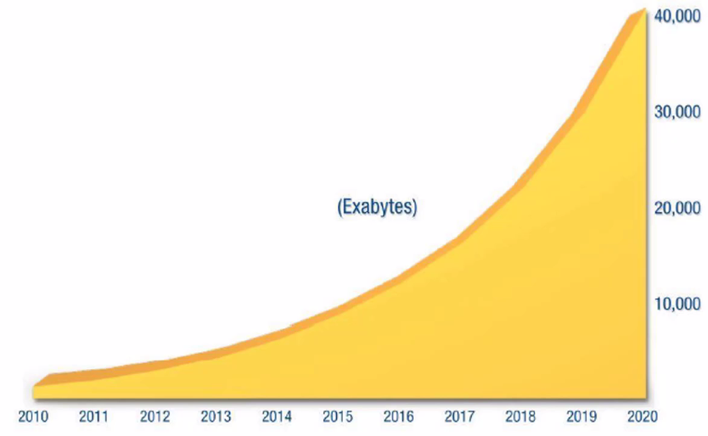
Why Machine Learning is the Future?

Slide 47
Machine Learning - Types
Broad categories based on:
Whether or not they are trained with human supervision
supervised, unsupervised, semisupervised, and Reinforcement Learning
Whether or not they can learn incrementally on the fly
online versus batch learning
Whether they work by simply comparing new data points to known data points, or instead detect patterns in the training data and build a predictive model, much like scientists do
instance-based versus model-based learning

Slide 48
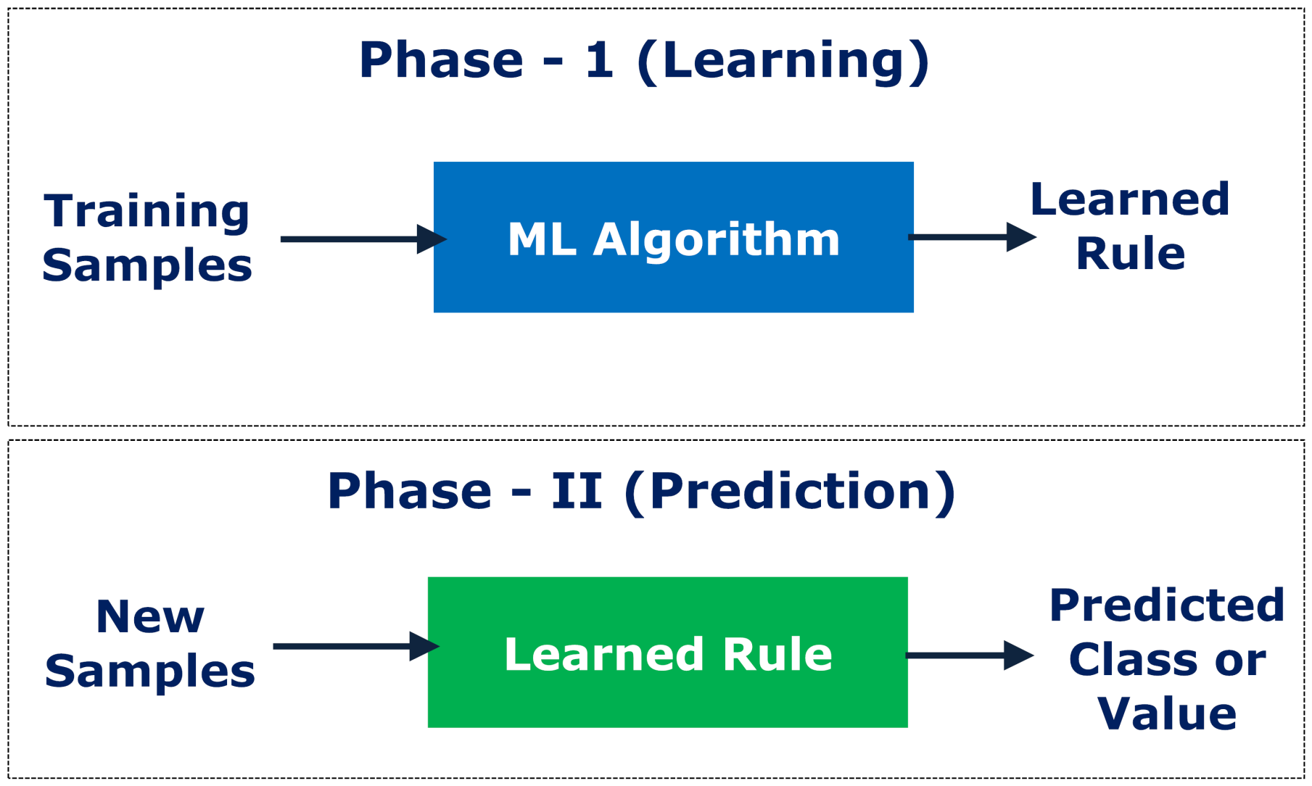
Machine Learning
Learning/training: build a classification or regression rule from a set of samples
Supervised -inductive
Given: training data + desired outputs (labels)
Unsupervised
Given: training data (without desired outputs)
Semi-supervised
Given: training data + a few desired outputs

Slide 49
Work Flow in ML Project
Define Problem/Collect Data: Investigate and characterize the problem in order to better understand the goals of the project.
Analyze Data: Use descriptive statistics and visualization to better understand the data you have available i.e. Plotting and finding features.
Prepare Data: Use data transforms in order to better expose the structure of the prediction problem to modeling algorithms.
Evaluate Algorithms: Design a test harness to evaluate a number of standard algorithms on the data and select the top few to investigate further.
Improve Results: Use algorithm tuning and ensemble methods to get the most out of well-performing algorithms on your data.
Present Results: Finalize the model, make predictions and present results i.e use the model with field data

